Slide 1
Burglary in Austin
Austin Public Safety Commission
March 7, 2011

Slide 2
Introduction
Local neighborhood associations in
Austin have expressed concerns about
an increase in residential burglary
While not “newsworthy,” burglaries
are common and the average citizen
is at risk of victimization
Residential burglary is a serious crime,
and victims can suffer from both
financial loss and psychological harm

Slide 4
70% Residential
30% Nonresidential

Slide 6
+26%
+33%
+11%
*Based on APD data (26% population growth in Austin).

Slide 7
-4%
+26%
-1%
-2%

Slide 8
+8%
+48%
+86%
+23%
*Does not include indirect (+71%) or CJS costs.
Notes:
Losses only include direct property losses and damages. The graph does not show indirect or CJS costs.
Indirect costs include medical expenses, lost work output, and intangibles (fear, suffering, lost quality of life, etc.), estimated at an additional 71% of direct costs.
CJS costs include criminal justice system expenses (e.g., police, prosecution, court, probation, prison, parole, etc.).

Slide 9
+102%
Total Loss $102,000,000
• 72% Residential
• 28% Nonresidential

Slide 10
-44%
Austin 5%
US average 13%

Slide 11
Citizen Led Austin Safety Partnership Safety Survey Results
Perceptions of Neighborhood Safety
Burglary of a residence is perceived as the “most critical” problem by a large majority (55%), with all other categories of crime trailing far behind. Ranking crime types, burglary of residence was followed by burglary of vehicle. In third place was traffic issues.

Slide 12
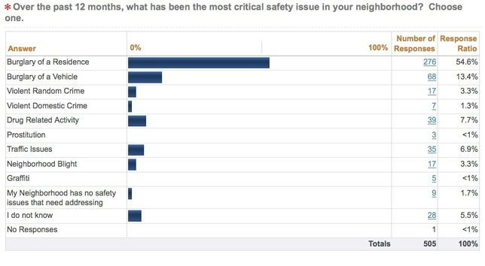
Most Critical Neighborhood
Safety Issue

Slide 13
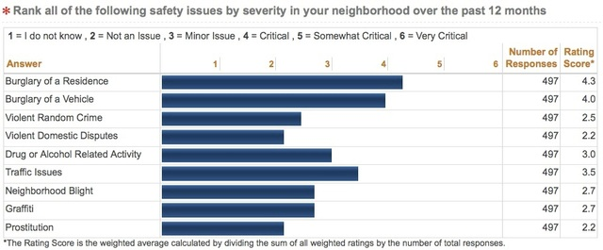
Ranking of Neighborhood Safety Issues by Severity

Slide 14
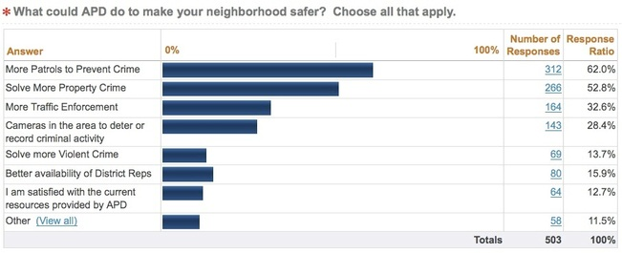
What can APD do to Make Your Neighborhood Safer?

Slide 15
Conclusions
Burglary is considered the most
critical crime problem in Austin
Austin’s burglary rate is typical,
but getting worse – over the past decade,
the residential burglary rate increased 33%
During the same time, APD’s clearance rate for solved burglaries dropped in half, to 5%
Burglary is an expensive crime – last year it cost the citizens of Austin over $14 million

Slide 16
Recommendations
1. More resources for burglary investigation:
Crime scene forensics
  DNA capability
Follow-up investigations
  Improve clearance rate
Targeted operations on prolific offenders
  10% of burglars commit 50% of burglaries
2. Intelligence-led policing model and
problem solving efforts

